Slide 1

WEB Development
Grade 7&8

Slide 2
Recap of the last Class
Notes:
Objective:
Review margin and padding in CSS.
Introduce HTML lists.
Teacher Instructions:
Recap margin and padding in CSS.
Highlight the shortcut for setting margin and padding for all sides.
Introduce today's topic: HTML lists.

Slide 3

Riddle
The giraffe is taller than the kangaroo but shorter than the palm.
Which animal is the tallest?
Notes:
Answer : Giraffe.
Objective:
Engage students with a riddle.
Teacher Instructions:
Present the riddle: "The giraffe is taller than the kangaroo but shorter than the palm. Which animal is the tallest?"
Discuss the answer.

Slide 4
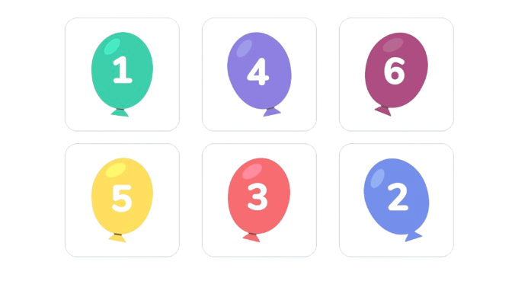
Riddle
Max took two good shots and gained 4 points.
Annie took two good shots and gained 6 points.
Which balloons are left?
Notes:
Answer : 5 & 6
Objective:
Continue engaging students with another riddle.
Teacher Instructions:
Present the riddle: "Max took two good shots and gained 4 points. Annie took two good shots and gained 6 points. Which balloons are left?"
Discuss different interpretations of the riddle.
Discuss the Answer.

Slide 5

Introduction to Lists
Notes:
Objective:
Introduce lists in HTML.
Teacher Instructions:
Explain the importance of lists for organizing information.
Show the screenshot and describe ordered and unordered lists.

Slide 6
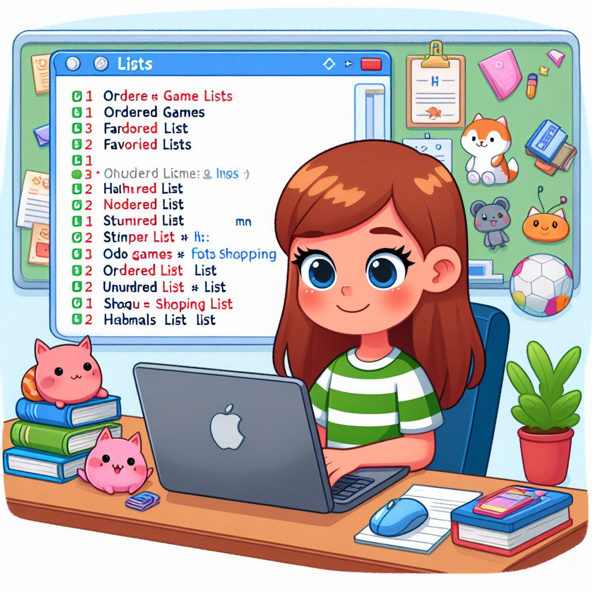
Emily's List Quest
Emily, enjoys playing games online, eagerly joined an HTML class to learn how to make her own website.
During the lessons, her teacher introduced the concept of lists, explaining how they organize information similar to to-do or shopping lists, with ordered lists being numbered and unordered lists using bullets.
Emily wants to add lists of her favorite games, foods, and animals to her website. But she is unsure how to create a list in HTML.
Let's help Emily create the list and organize her favorites
Notes:
Objective:
Provide a relatable context for learning lists in HTML.
Teacher Instructions:
Share Emily's story about learning HTML and wanting to create lists.
Explain the goal: helping Emily create lists of her favorite games, foods, and animals.

Slide 7
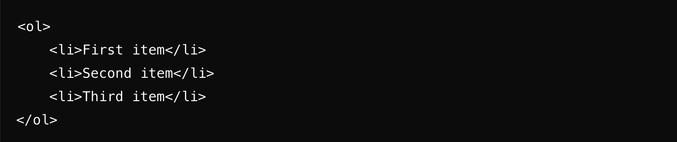
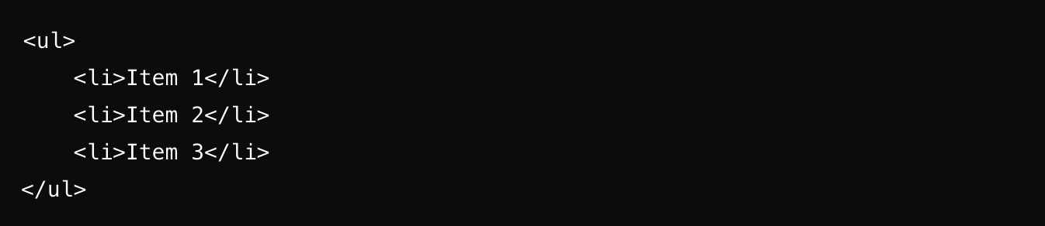
Introduction to Lists
In HTML We have two fundamental types of lists
How it Looks:
Ordered List
Unordered List
Notes:
Objective:
Explain the two main types of lists in HTML.
Teacher Instructions:
Describe ordered lists (<ol>) and unordered lists (<ul>).
Show the screenshot of the list syntax.

Slide 8
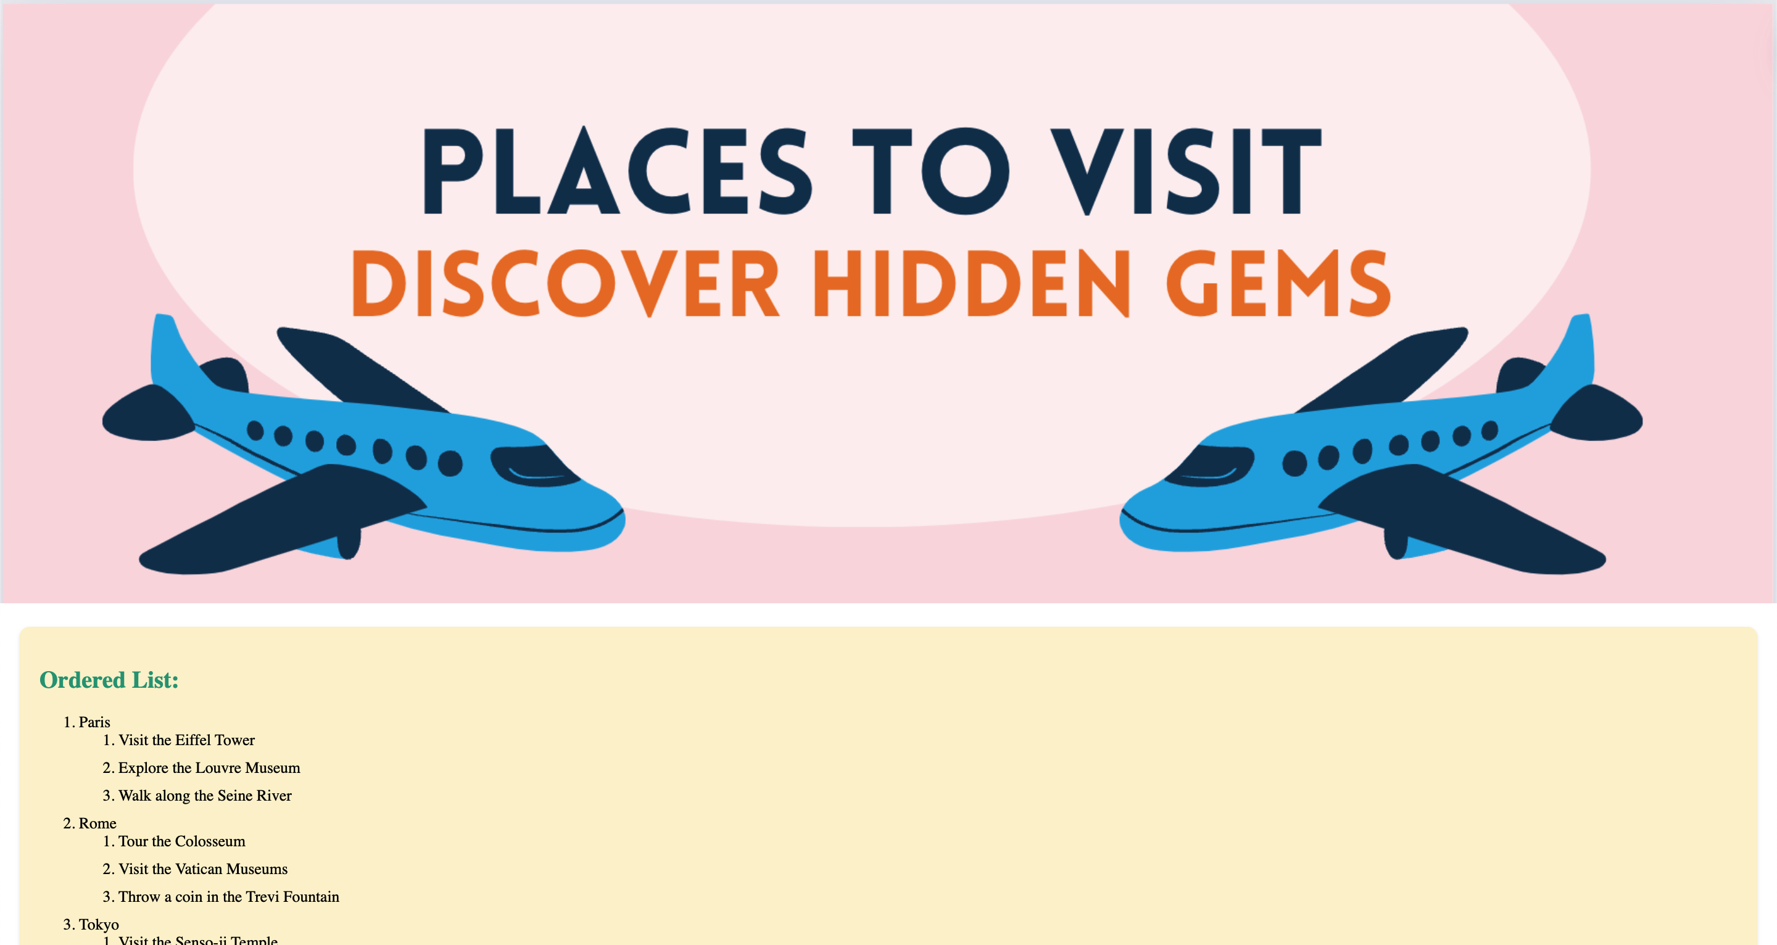
Project – Travel Itinerary
Notes:
Project Link: https://replit.com/@vijayselfcode/Project-Class-7-G-5and6
Objective:
Introduce the project example.
Teacher Instructions:
Present the final travel itinerary project.
Explain that students will create a similar project using lists.

Slide 9
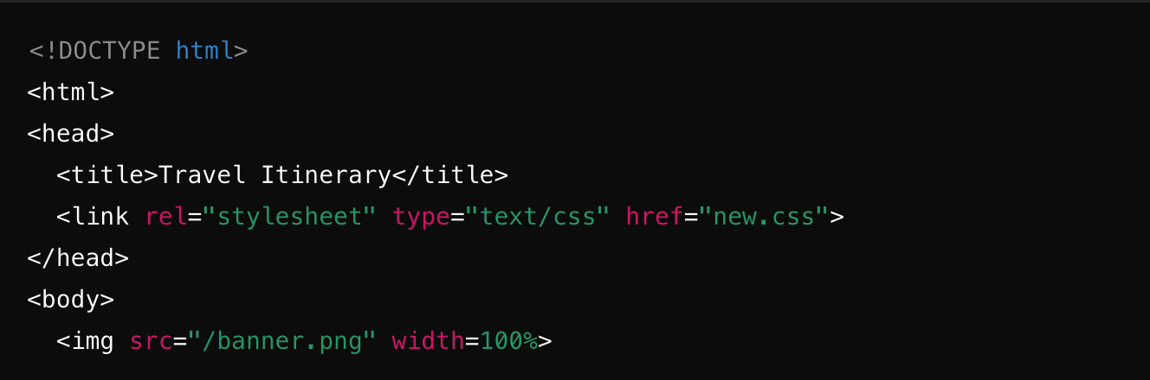
Working with the Project
HTML Code Explanation
Notes:
"Teacher's Activity"
Objective:
Explain the HTML code structure.
Teacher Instructions:
Show the HTML code screenshot.
Describe the basic HTML structure and its elements.

Slide 10
Working with the Project
HTML Code Explanation
<!DOCTYPE html> : This tells the browser that the document is in HTML5.
<html> : This is the start of the HTML document.
<head> : Contains meta-information about the document, like the title and links to stylesheets.
<title> : Sets the title of the web page, shown on the browser tab.
<link> : Connects the HTML to a CSS file for styling.
<body> : The main content of the HTML document.
<img src="/banner.png" width=100%> : Displays an image at the top of the page, taking up 100% of the width.
Notes:
Objective:
Explain specific HTML elements.
Teacher Instructions:
Detail the purpose of key HTML elements like <!DOCTYPE html>, <html>, <head>, <title>, <link>, and <body>.
Explain the <img src='/banner.png' width=100%> tag and its function.

Slide 11
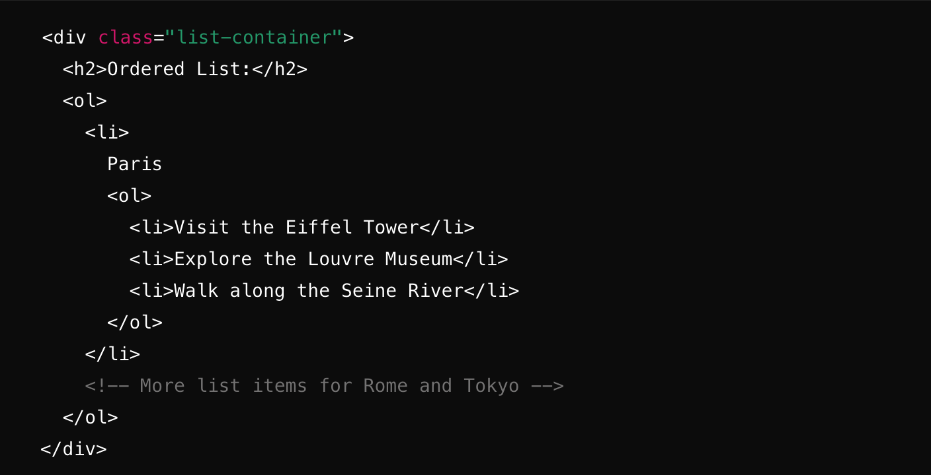
Working with the Project
HTML Code Explanation
Notes:
Objective:
Detail the HTML list elements.
Teacher Instructions:
Explain the use of <div class='list-container'>, <h2>, <ol>, and <li> tags.
Show the screenshot and discuss nested lists.

Slide 12
Working with the Project
HTML Code Explanation
<div class="list-container"> : A section of the page with a special background and border.
<h2> : A heading that says "Ordered List:".
<ol> : Starts an ordered (numbered) list.
<li> : A list item. Inside, there's another <ol> for sub-items.
Notes:
Objective:
Explain nested list elements.
Teacher Instructions:
Describe how to nest lists within lists using <ol> and <ul> tags.

Slide 13
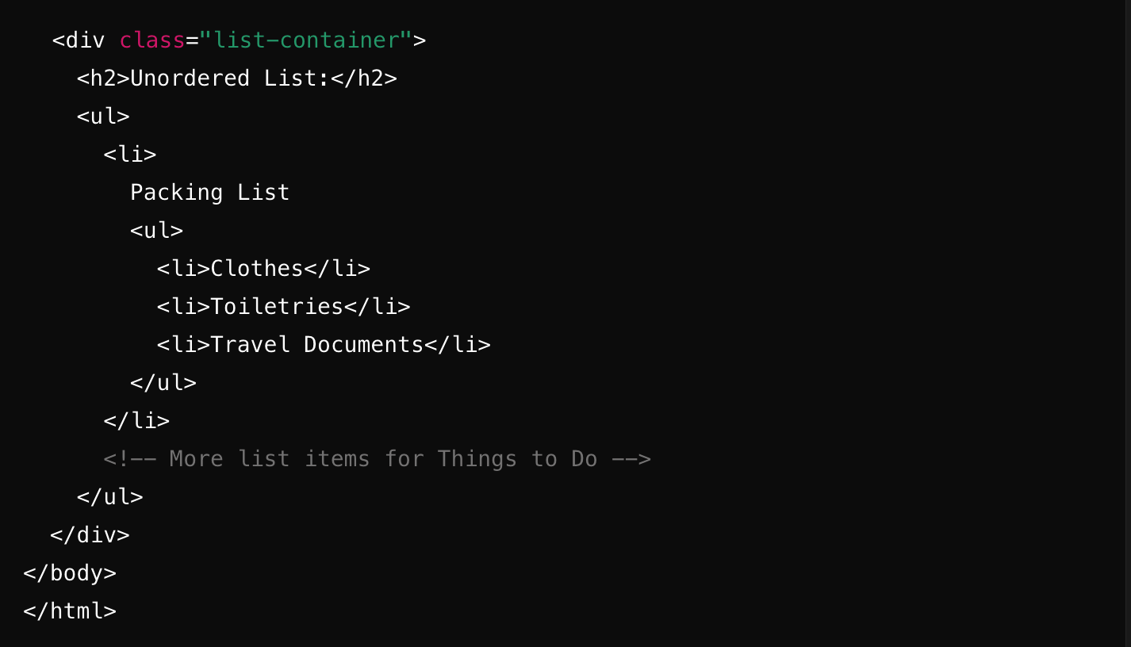
Working with the Project
HTML Code Explanation
Notes:
Objective:
Explain unordered lists in HTML.
Teacher Instructions:
Describe the use of <ul> tags for unordered lists.
Show the screenshot and explain the difference from ordered lists.

Slide 14
Working with the Project
HTML Code Explanation
<ul> : Starts an unordered (bulleted) list.
Similar to the ordered list but uses bullets instead of numbers.
Notes:
Objective:
Explain unordered lists in HTML.
Teacher Instructions:
Describe the use of <ul> tags for unordered lists.
Explain student that we can nest an ordered list into an Unordered list. And vice-versa

Slide 15
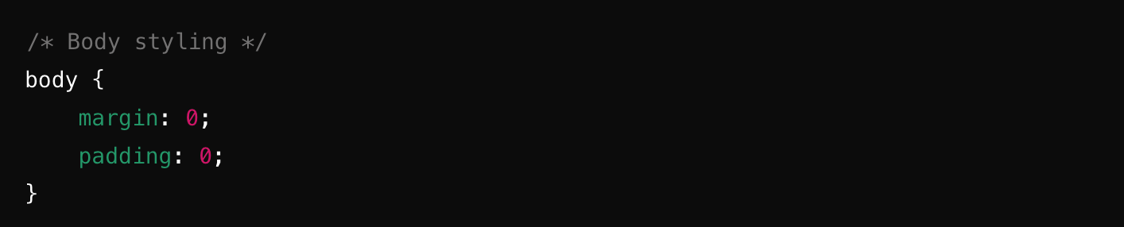
Working with the Project
CSS Code Explanation
body: This sets the overall page margins and padding to zero, making the page start right at the edges.
Notes:
Objective:
Introduce CSS styling for lists.
Teacher Instructions:
Show the CSS code screenshot.
Explain setting overall page margins and padding to zero.

Slide 16
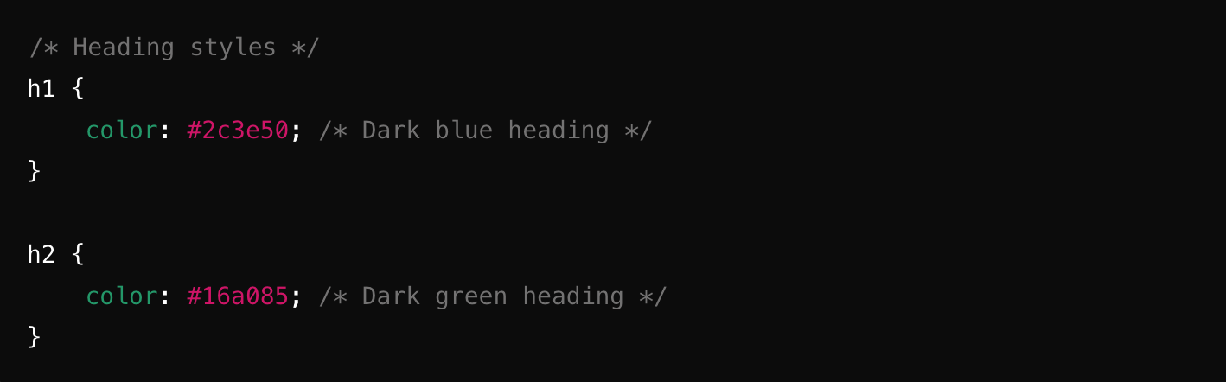
Working with the Project
CSS Code Explanation
h1 and h2: These style the main headings with different colors.
Notes:
Objective:
Explain CSS styling for headings.
Teacher Instructions:
Show the screenshot.
Describe styling for h1 and h2 tags with different colors.

Slide 17
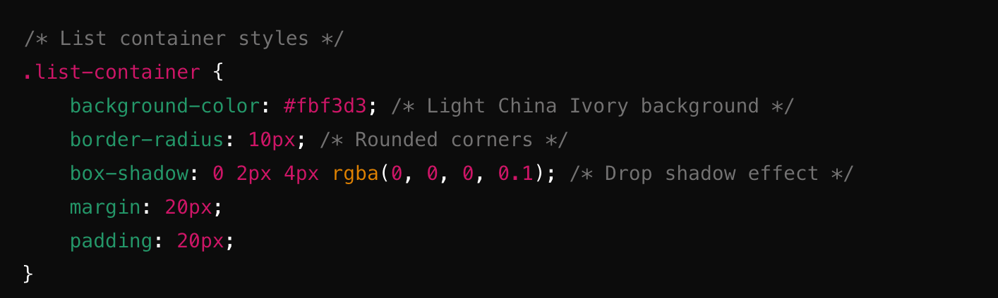
Working with the Project
CSS Code Explanation
Notes:
Objective:
Explain CSS styling for list containers.
Teacher Instructions:
Show the screenshot.
Explain styling for .list-container sections including background color, border radius, box shadow, margin, and padding.

Slide 18
Working with the Project
CSS Code Explanation
.list-container : Applies styles to the sections containing lists.
background-color: #fbf3d3; : Sets a light yellowish background color.
border-radius: 10px; : Makes the corners of the section rounded.
box-shadow: 0 2px 4px rgba(0, 0, 0, 0.1); : Adds a small shadow around the section to give it a slight 3D effect.
margin: 20px; : Adds space around the section.
padding: 20px; : Adds space inside the section, around the content.
Notes:
Objective:
Explain CSS styling for list containers.
Teacher Instructions:
Explain styling for .list-container sections including background color, border radius, box shadow, margin, and padding.

Slide 19
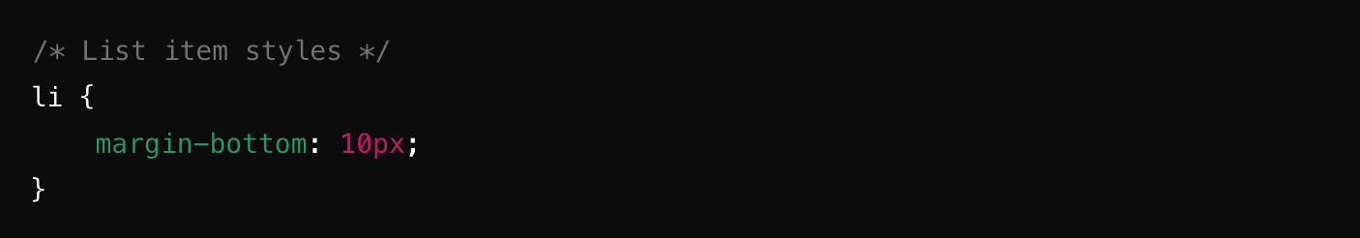
Working with the Project
CSS Code Explanation
li: Adds some space below each list item to make the list easier to read.
Notes:
Objective:
Explain CSS styling for list items.
Teacher Instructions:
Show the screenshot.
Describe adding space below each <li> for better readability.

Slide 20
Now it's your turn!
Task: Follow the teacher's guidance and explore how to use lists in HTML.
Notes:
"Students' Activity"
Objective:
Engage students in hands-on practice.
Teacher Instructions:
Guide students to create their own lists in HTML.
Encourage them to apply the CSS styles discussed.

Slide 21

How to Save & Share the project.
Replit offers autosave option – so not worry about the same.
To share project with someone in view mode: just copy the link from the URL bar, and share the link
To share the project for collaboration
Click on "Invite" from the top right corner
If you know the username, type it in the box and click on invite
You can also turn on the toggle button "private join link" to create a public collaboration link and invite members to edit your code.
Notes:
Instructions for the Teacher:
Explain how to save and share projects on Replit, including the options for collaboration.
Emphasize the importance of sharing projects for feedback and collaboration.

Slide 22


Which HTML tag is used to create an unordered list?
a) <ol>
b) <ul>
c) <li>
d) <dl>
Notes:
Answer: B

Slide 23
What is the default bullet style for items in an unordered
List ?
A. Circle
B. Square
C. Disc
D. None
Notes:
Answer: C

Slide 24
Which tag is used to create a new list item in HTML?
a) <li>
b) <list>
c) <item>
d) <ul>
Notes:
Answer: B

Slide 25
How do you create a bulleted list in HTML?
a) Using the <ol> tag
b) Using the <ul> tag
c) Using the <li> tag
d) Using the <bl> tag
Notes:
Answer: B

Slide 26

Let's Wrap it Up – What have we learnt?
Today, we learned about lists in HTML and their types. We covered:
Ordered Lists (<ol>):
These lists use numbers to organize items.
Example: A list of destinations with numbered activities.
Unordered Lists (<ul>):
These lists use bullets to organize items.
Example: A packing list with bulleted items.
Notes:
Objective:
Summarize the lesson.
Teacher Instructions:
Review the types of lists in HTML: ordered lists (<ol>) and unordered lists (<ul>).
Discuss examples and applications of each list type.

Slide 27


Homework Discussion
Notes:
Instructions for the Teacher: Facilitate a discussion about the homework assignment.

Slide 28

Brain Booster Bonus
Task Description:
Hey kids! Let's have fun with HTML and CSS!
First, we'll make a digital dictionary. Think of interesting words and their meanings, and put them into lists (Use Descriptive List.)
Then, we'll use CSS to make those lists look awesome! We can try different styles like circles, squares, Bullets and other list style type.
Notes:
Objective:
Provide an extra activity for advanced students.
Teacher Instructions:
Explain the task of creating a digital dictionary using <dl> for descriptive lists.
Encourage students to style their lists with CSS using different list styles like circles, squares, etc.

Slide 29

Be Mindful of Online Friends
Many websites will ask your permission for notifications, give access to only trusted websites.
Liam received a friend request from someone he didn't know while playing an online game and accepted it without asking.
The stranger started asking personal questions, making Liam feel uncomfortable, so he told his parents who helped him block the person.
The moral of the story: only add friends you know in real life on games and social media, and ask a parent if it's safe to accept friend requests from strangers

